Slide 1
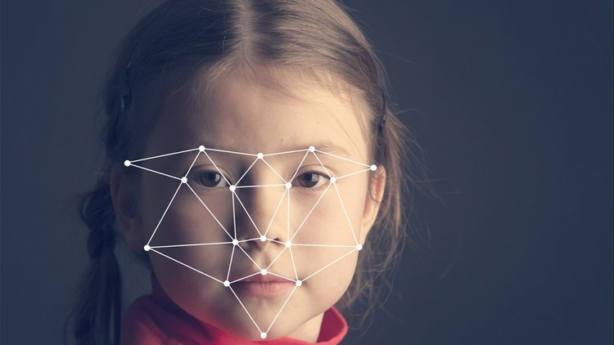
HUMAN FACE-HAND
DETECTION WITH
OPENCV USING
MACHINE LEARNING

Slide 2
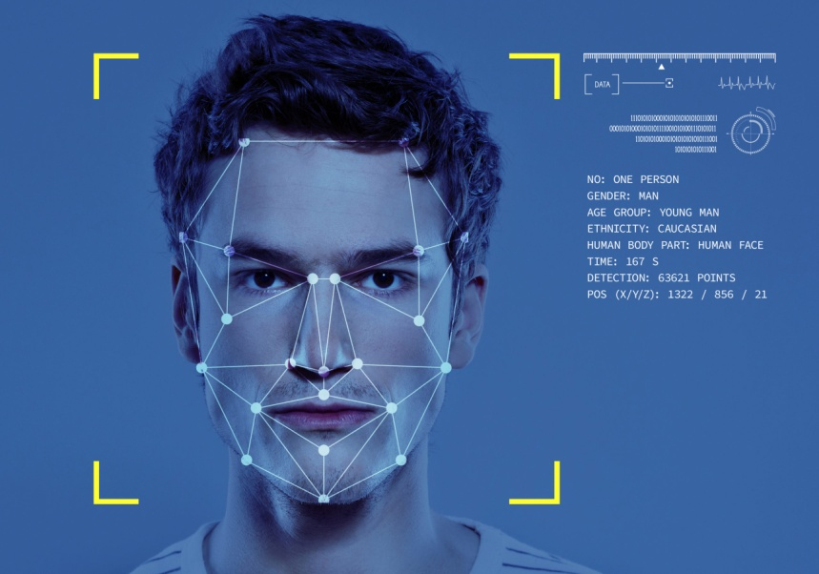
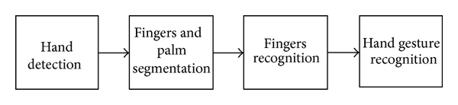
Introduction
Face detection is a computer technology being used in a variety of applications that identifies human faces in digital images. Face detection also refers to the psychological process by which humans locate and attend to faces in a visual scene.
The overview of the hand gesture recognition is that, first the hand is detected using the background subtraction method and the result of hand detection is transformed to a binary image. Then, the fingers and palm are segmented so as to facilitate the finger recognition.

Slide 3
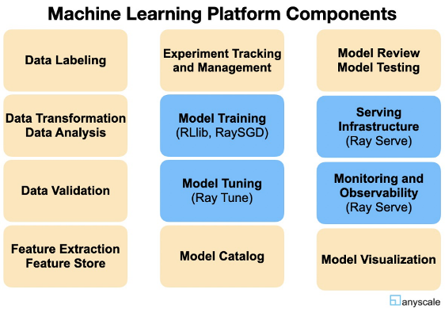
Functionality
Face detection helps identify which parts of an image or video should be focused on to determine age, gender and emotions using facial expressions.
Uses sensors to read and interpret hand movements as commands, single-shot detector provides centered bounding boxes for detected human palms.
Hand detection is a crucial pre-processing procedure for many human hand related computer vision tasks, such as hand pose estimation, hand gesture recognition, human activity analysis,

Slide 4
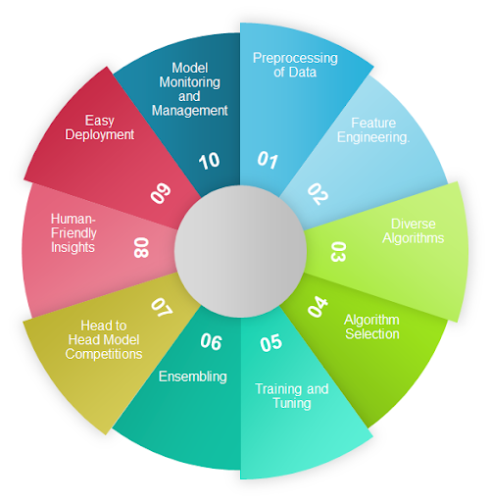
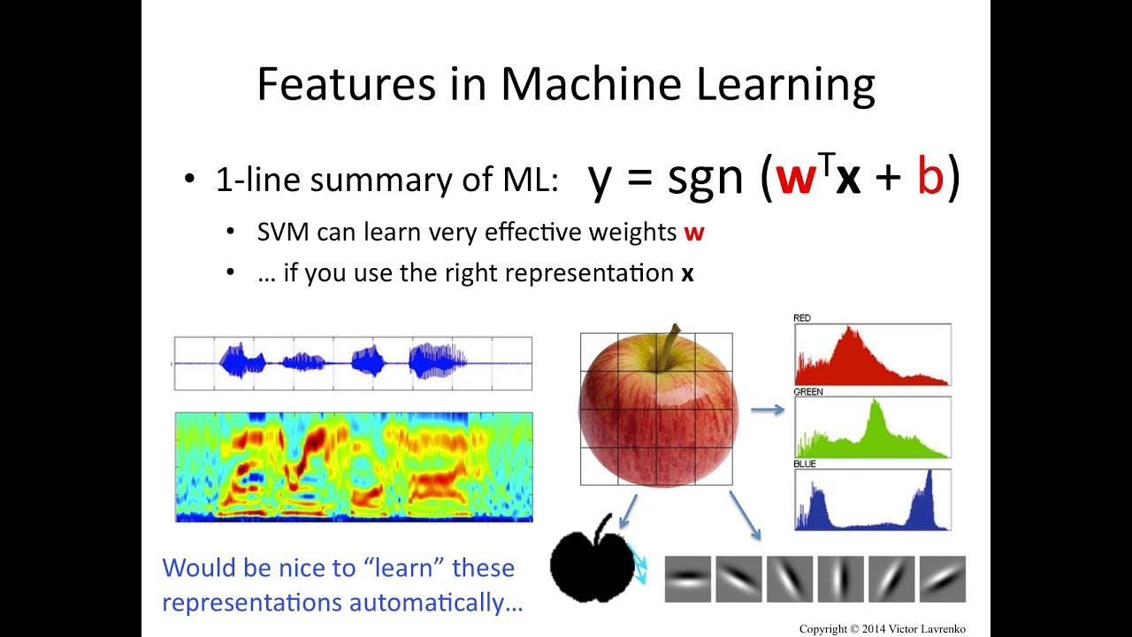
features
Detect Every Part Of Face Feature Allows The Examiner To Get More Accurate Reorganization Of The Person Whose Photo Has Been Taken
Count the given numbers on your fingers and find the correct finger on which the number ends.
Face detection technology can be applied to various fields -- including security, biometrics, law enforcement, entertainment and personal safety -- to provide surveillance and tracking of people in real time.

Slide 5
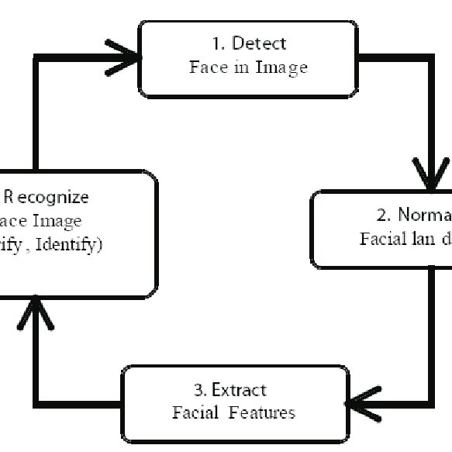
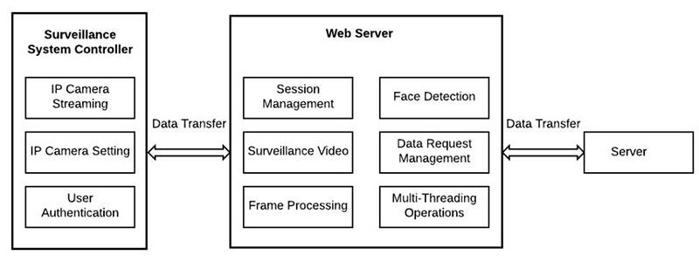
PROJECT PLANNING FOR FACE RECOGNITION
To create a complete project on Face Recognition, we must work on 3 very distinct phases:
Face Detection and Data Gathering
Train the Recognizer
Face Recognition.
Step 1: Face detection. The camera detects and locates the image of a face, either
alone or in a crowd. ...
Step 2: Face analysis. Next, an image
of the face is captured and analyzed. ...
Step 3: Converting the image to data. ...
Step 4: Finding a match.

Slide 6
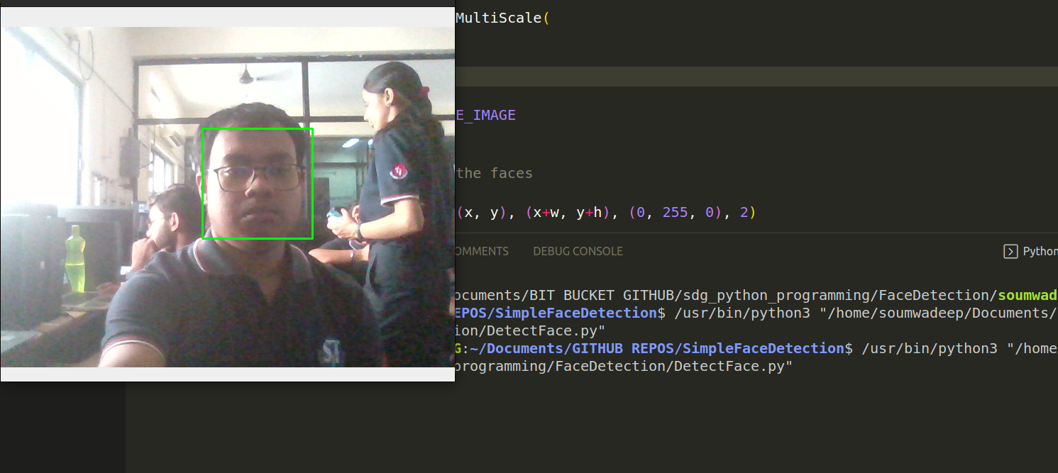
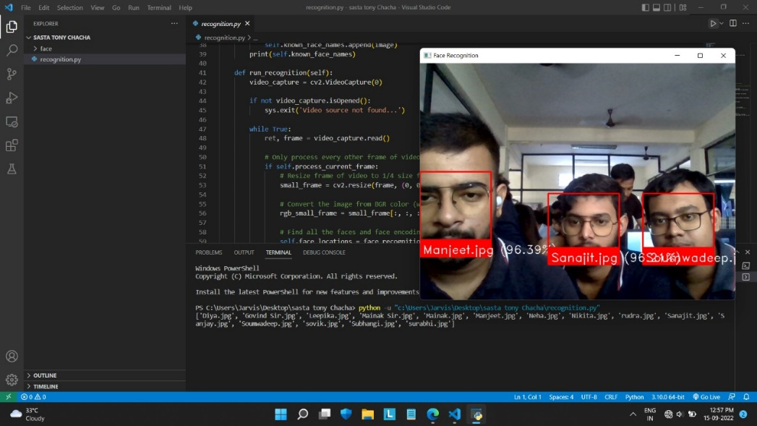
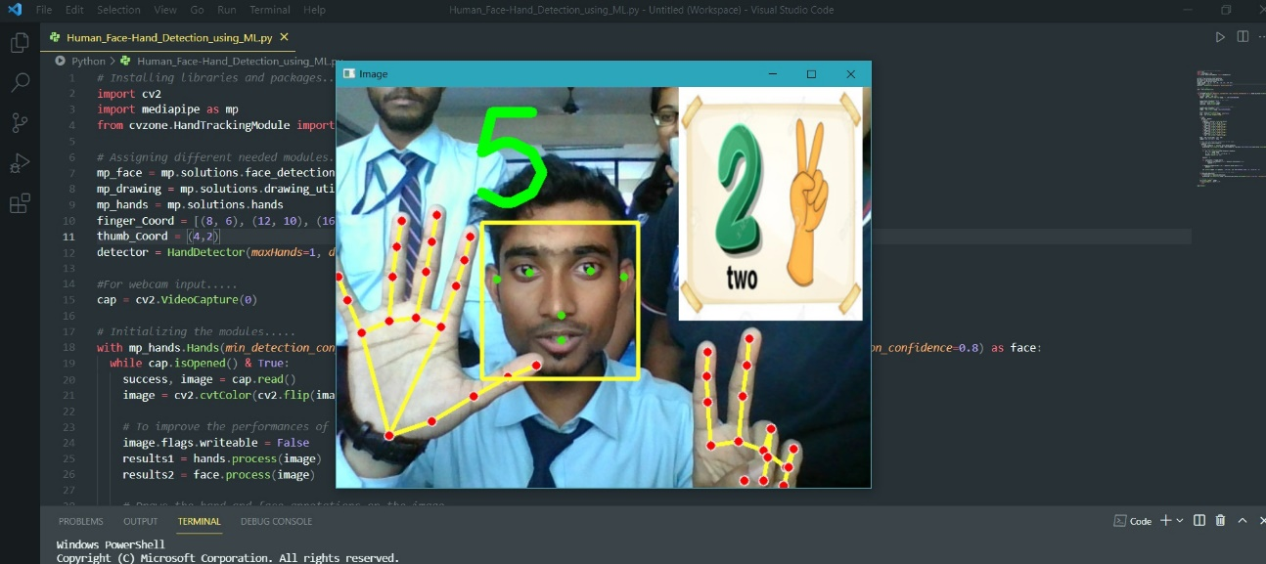
CODE:
STAGE-1
STAGE-2
STAGE-3

Slide 7

CONCLUSION
Our Project Is Created With
The Help Of Python And
OpenCV. We Have Tried Our Best
To Implement:
Face Detection
Hand Movement Recognisation
Face Detection With Their Name
Counting Numbers With Fingers Of Both Hands
Synchronising Both Hands At The Same Time
Multi Functioning Of Both Hands
Our Face Detection Has 93.87% Accuracy Which Can Detect Any Face Without Any Errors With Right Data.
The Best Feature Is Of Our Hand Synchronization. We Can Seamlessly Use Our 2 Hands To Show Different Expression And Count The Numbers Of Each Hands At The Same Time.

Slide 8
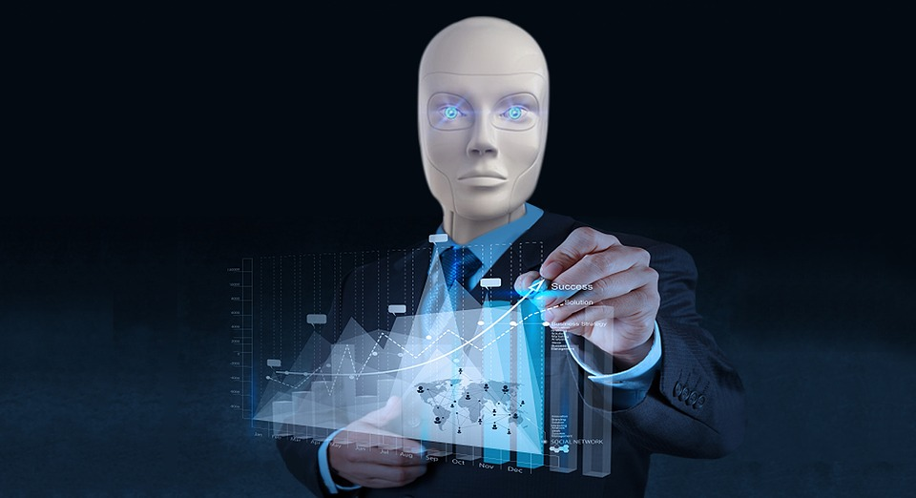
BIBLIOGRAPHY :
https://www.w3schools.com/
https://www.codewithharry.com/
https://www.javatpoint.com/
https://www.tensorflow.org/
https://www.techtarget.com

Slide 9
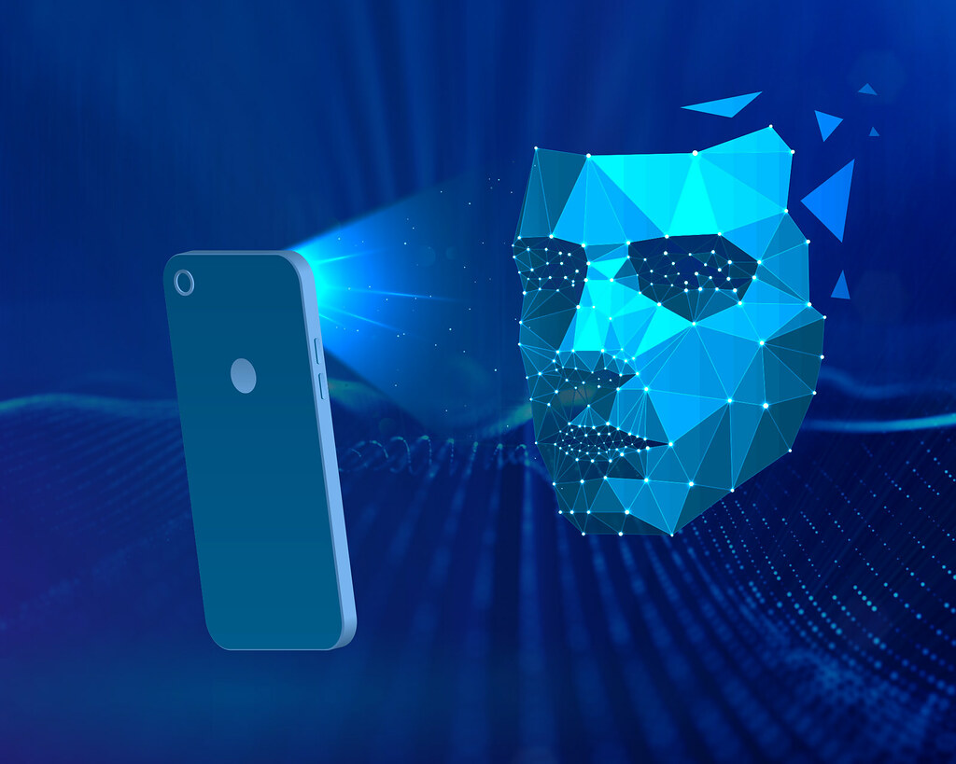
THANK YOU..
Project Done By:
1.Sumit Dhar
2.Soumwadeep Guha
3.Sanajit Bhunia
4.Manjeet Sharma
5.Nikita Kundu
6.Neha Datta
7.Surabhi Saha
8.Diya Sarkar
This Photo by Unknown Author is licensed under CC BY

